Slide 1
OSS PaaS and DevOps
Jonathan Perez
Notes:
Information in this document, including URL and other Internet Web site references, is subject to change without notice. Unless otherwise noted, the example companies, organizations, products, domain names, e-mail addresses, logos, people, places, and events depicted herein are fictitious, and no association with any real company, organization, product, domain name, e-mail address, logo, person, place or event is intended or should be inferred. Complying with all applicable copyright laws is the responsibility of the user. Without limiting the rights under copyright, no part of this document may be reproduced, stored in or introduced into a retrieval system, or transmitted in any form or by any means (electronic, mechanical, photocopying, recording, or otherwise), or for any purpose, without the express written permission of Microsoft Corporation.
Microsoft may have patents, patent applications, trademarks, copyrights, or other intellectual property rights covering subject matter in this document. Except as expressly provided in any written license agreement from Microsoft, the furnishing of this document does not give you any license to these patents, trademarks, copyrights, or other intellectual property.
The names of manufacturers, products, or URLs are provided for informational purposes only and Microsoft makes no representations and warranties, either expressed, implied, or statutory, regarding these manufacturers or the use of the products with any Microsoft technologies. The inclusion of a manufacturer or product does not imply endorsement of Microsoft of the manufacturer or product. Links may be provided to third party sites. Such sites are not under the control of Microsoft and Microsoft is not responsible for the contents of any linked site or any link contained in a linked site, or any changes or updates to such sites. Microsoft is not responsible for webcasting or any other form of transmission received from any linked site. Microsoft is providing these links to you only as a convenience, and the inclusion of any link does not imply endorsement of Microsoft of the site or the products contained therein.
© 2020 Microsoft Corporation. All rights reserved. Microsoft and the trademarks listed at https://www.microsoft.com/en-us/legal/intellectualproperty/Trademarks/Usage/General.aspx are trademarks of the Microsoft group of companies. All other trademarks are property of their respective owners.

Slide 2
Abstract and learning objectives
Abstract
In this whiteboard design session, you work with a group to design a solution for integrating and deploying complex open-source software (OSS) workloads into Azure PaaS. Your solution should handle the migration of an existing MERN (MongoDB, Express.js, React.js, Node.js) stack application. The application will be migrated from a hosted environment into Azure PaaS services, including migrating an existing MongoDB instance into Cosmos DB, enhancing application functionality using serverless technologies, and fully embracing modern DevOps tools.
At the end of this whiteboard design session, you will be better able to design solutions for migrating OSS applications into Azure PaaS using modern DevOps methodologies.

Slide 3
Step 1: Review the customer case study
Outcome
Analyze your customer needs.
Timeframe
15 minutes

Slide 4

Customer situation
DKSH is a leader in the food service distribution business
OSS development shop
Current infrastructure has become challenging and limiting
Looking for cloud PaaS solutions for OSS applications
Notes:
DKSH is one of the leading online health food suppliers in Malaysia. They launched their highly-successful e-commerce website, which sells subscriptions to their food ingredients supply business, in 2015 (this is a fictional scenario), and quickly gained a large subscriber-base. Since then, their customer numbers have continued to grow. Their service is tailored towards working professionals, who want convenient, reliable access to healthy meal choices, and pre-packaged recipes, without having to speed too much time preparing the meals.
Their customer-facing web app was built using Open Source Software (OSS) and is currently hosted in on-premise Linux Virtual Machines. App development was done using the MERN stack (MongoDB, Express.js, React.JS, Node.js), and their code is hosted in a private GitHub repository. A point of pride for DKSH has been their developers’ involvement in the open source community, with most members of the team frequently contributing to React.js on GitHub.
They have reached a point where managing their VM and server infrastructure is becoming a real challenge. For example, their current meal plans include only dinner options, but DKSH has received feedback from many customers expressing a desire to receive breakfasts as part of the service offering. They would like to expand their meal service to include breakfasts to meet this demand, but feel they first need to address their rising infrastructure costs and management time.
Michael Chew, VP of DKSH Malaysia, is interested in understanding more about Platform as a Service (PaaS) solutions for OSS applications that could help them focus their time and expenditures on their core business, rather than infrastructure. “We’re finding that with every upgrade, we’re spending more time and money on infrastructure, and less on delivering the functionality and features that matter most to our customers,” says Tay, “and we need to rebalance those efforts.”
Interested in reusing as much code and architecture as possible
Mentioned existing knowledge of Docker, and are curious about possible container approaches to migrating their OSS app
Looking for enhancements to their existing Jenkins build pipeline
Want to know if automating their order processing and customer notifications using serverless architecture is feasible
Would like to explore the possibility of implementing a new user name and password management system
Want to continue using GitHub for their code repository
Very concerned about potential application changes needed to move their OSS application into a cloud PaaS solution

Slide 5

Customer needs
Migrate as much infrastructure as possible into the cloud
Reuse existing code and architecture
Improve DevOps workflow, while continuing to use GitHub repo
Maintain dedication to OSS
Notes:
Wants to migrate as much of their infrastructure as possible to the cloud to make it easier to take advantage of the scalability, reliability, and performance of a PaaS solution, and reduce the burden of building out and managing hardware and software.
Would like to reuse as much code and architecture as possible.
We want the migration to be non-invasive.
Although the existing code has its nuances and issues, we do not want to redesign the entire solution to migrate to the cloud.
Would like to continue using MongoDB APIs for data storage, to avoid having to rewrite application data access code, but don’t want to worry about managing infrastructure, consistency, replication, etc.
Want to continue to use their GitHub repository for source control, and Jenkins for their builds, but are interested in any value-added functionality available in Azure which could integrate into their CI/CD pipeline, especially around release management.
Want to maintain a dedication to open source technologies, and maintain those same technologies within the cloud solution, while taking advantage of integrations with the cloud environment, where possible.

Slide 6
Customer needs (continued)
Integrate serverless architecture
Replace identity management solution
Add search capabilities
Ability to rapidly build, test, and deploy application updates
Notes:
Looking for opportunities to integrate automated, serverless processes into their application
Implement weekly order processing, based on customer specified preferred day of delivery
Send SMS notifications to customers when order processing complete, and their weekly package is on its way
Desire a replacement solution for safeguarding and managing user identities
Customers must be registered and logged in to place orders
Replace existing home-grown solution
Add search capabilities to our application, providing the ability for customers to find meals or options
Ability to rapidly build, test, and deploy application updates
Automate and simplify deployments through continuous Integration/continuous delivery (CI/CD) capabilities

Slide 7
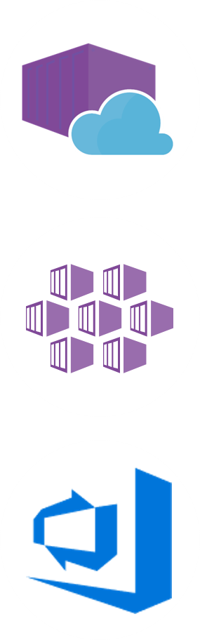
Customer objections
Can Azure PaaS really host an OSS app?
Are containers a feasible option in Azure?
Can Azure help improve our DevOps workflow?
Is Azure Active Directory B2C (Azure AD B2C) an option with OSS apps?
Notes:
Can Azure really host on OSS application using PaaS?
We’re interested in using containers, but we’re not sure how they work in Azure. Does Azure provide reliable ways to deploy and manage containers? What is the simplest way to move containers to Azure, based on our PaaS experience, while at the same time considering our scale and growth requirements?
We would like to improve our current DevOps workflow. What options are available in Azure? Can we implement a CI/CD pipeline? Can we continue to use Jenkins? Does Azure offer any value-added services which we can leverage in our Jenkins CI/CD pipeline?
We’ve heard about Azure Active Directory B2C to manage application users, but we are not sure how that would work with our open source application.

Slide 8
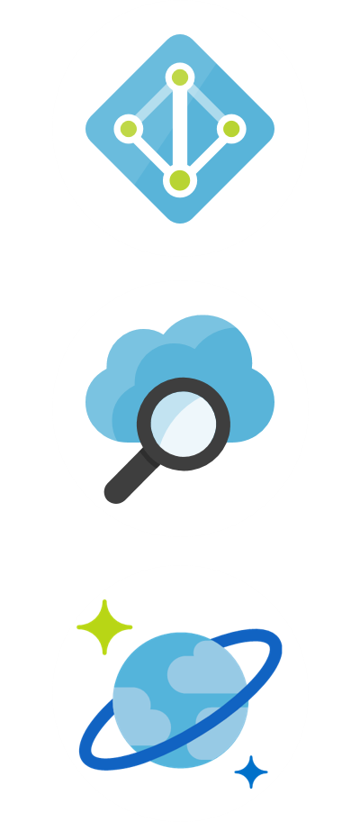
Customer objections (continued)
Is Azure Search an appropriate solution for improving our search capabilities?
Can we continue to use MongoDB API?
How can we leverage serverless architecture?
Can we continue using our development tools, or is VS Code a better option?
Notes:
Is Azure Search an appropriate solution for improving the search capabilities of our OSS app?
Will we be able to continue using the MongoDB API, while benefiting from the scalability and reliability of a PaaS database platform?
We would like to understand more about the benefits of a serverless architecture. In Azure does it mean only using Azure Functions or is there more to it?
We’ve read that Visual Studio Code is a free, open source code editor that can be used for OSS development. Can our developers continue to use their IDE, or do they need to switch over to using Visual Studio Code to write code destined for the Azure platform? Does Visual Studio Code offer any features or integration capabilities that would make it advantageous over a non-Microsoft IDE?

Slide 9

Common scenarios
Notes:
This is a diagram of a common architecture for this type of scenario, from which you can draw inspiration. You will find this diagram within the Whiteboard Design Session Student Guide.

Slide 10
Step 2: Design the solution
Outcome
Design a solution and prepare to present the solution to the target customer audience in a 15-minute chalk-talk format. (split into 2 groups)
Timeframe
60 minutes
Business needs (10 minutes) | Respond to questions outlined in your guide and list the answers on a flipchart.
Design (35 minutes) | Design a solution for as many of the stated requirements as time allows. Show the solution on a flipchart.
Prepare (15 minutes) | Identify any customer needs that are not addressed with the proposed solution. Identify the benefits of your solution. Determine how you will respond to the customer’s objections. Prepare for a 15-minute presentation to the customer.

Slide 11
Step 3: Present the solution
Outcome
Present a solution to the target customer in a 15-minute chalk-talk format.
Timeframe
30 minutes (15 minutes for each team to present and receive feedback)
Directions
Present the solution online.
One group is the Microsoft team and the other group is the customer.
The Microsoft team presents their proposed solution to the customer.
The customer asks one of the objections from the list of objections in the case study.
The Microsoft team responds to the objection.
The customer team gives feedback to the Microsoft team.

Slide 12
Wrap-up
Outcome
Identify the preferred solution for the case study.
Identify solutions designed by other teams.
Timeframe
15 minutes

Slide 13

Preferred target audience
Michael Chew, VP of DKSH
Primary audience is business and technology decision makers
Usually talk to Infrastructure Managers who report to the CIO, or to application sponsors (like a VP LOB, CMO) or to those that represent the Business Unit IT or developers that report to application sponsors
Notes:
Michael Chew, VP of DKSH
The primary audience is business and technology decision makers.
Usually we talk to the Infrastructure Managers who report to the CIO, or to application sponsors (like a VP LOB, CMO) or to those that represent the Business Unit IT or developers that report to application sponsors.

Slide 14
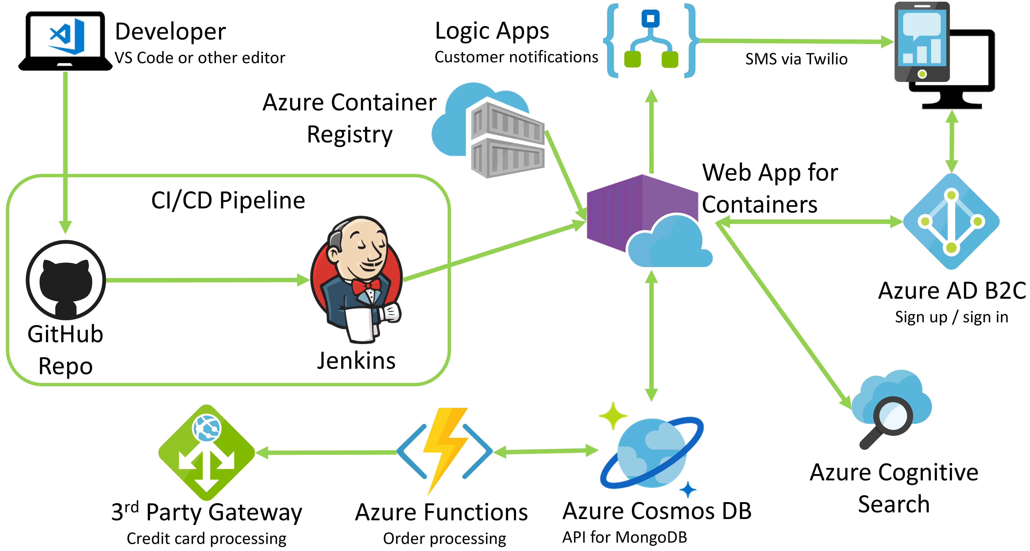
Preferred solution
Notes:
This preferred solution is just one of many viable options.
From a high-level:
The entire application is packaged inside a Docker container, and deployed to Microsoft Azure. In addition to the container-based apps, Azure resources, such as Cosmos DB, Azure Cognitive Search, Azure Functions, and Logic Apps, are used to implement and augment the application.
Developers will package the OSS application inside a custom Docker container using VS Code or another code editor
The Docker image will be pushed to an Azure Container Registry as part of a continuous integration process using Jenkins, GitHub, and Azure DevOps.
This Docker image will then be deployed to a Web App for Containers instance, as part of their continuous delivery process using Release Management in Azure DevOps.
The MongoDB database will be imported into Azure Cosmos DB
Connection strings in application updated to point to Azure Cosmos DB
Use Azure Database Migration Service (DMS) to migrate the on-premises MongoDB database into Cosmos DB’s API for MongoDB. Alternatively, use mongoimport or mongorestore to import existing data
Access to the Cosmos DB database from the application will continue to use the MongoDB APIs
Serverless architecture will be applied to order processing and customer notifications.
Azure Functions will be used to automate the processing of orders, billing credit cards, and updating the database as order processing is complete.
Logic Apps will be applied to send SMS notifications, via a Twilio connector, to customers informing them that their order has been processed and shipped.
Azure Search will be used to provide enhanced search functionality in the app.
Access to the containerized web app will be secured using Azure Active Directory B2C, which will handle all identity management, including the sign-up and sign-in processes.

Slide 15
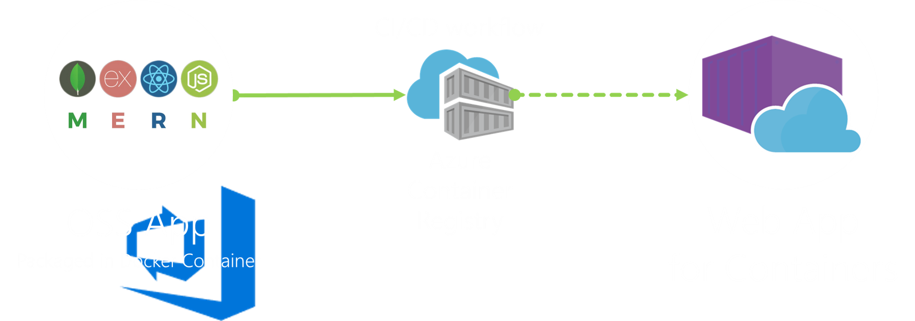
Preferred solution: PaaS solution
Notes:
What PaaS solution would you propose to Best For You Organics Company for moving their application into Azure? Will this solution minimize the number of application code changes required to migrate the application? How would container orchestration be handled?
Azure App Service on Linux and Web App for Containers would be possible options for Best For You Organics Company. Both were designed with the intention of supporting OSS workloads inside Azure App Service. Azure App Service on Linux provides multiple built-in images, catering to developers who want to use FTP or GIT, deploy .NET Core, Node, PHP or Ruby applications to Azure App Service running on Linux. Web App for Containers provides developers more control over the packages, runtime frameworks, and tooling through the use of custom Docker images.
Considering Best For You Organics’ desire to reuse as much code and architecture as possible, along with their previous experience with Docker, Web App for Containers would provide the best approach to quickly and easily migrating their application to Azure. Using Web App for Containers would enable Best For You Organics’ to reuse most, if not all, of their existing code and architecture. The development team would just need to create a custom Docker image for their application, and upload that to their registry.
Web App for Containers was designed leveraging years of Microsoft’s Azure App Service PaaS innovations, and allows developers to just focus on composing their containers without worrying about managing and maintaining an underlying container orchestrator. Container orchestration is obfuscated away from developers, and handled as part of the managed services.
Describe the scalability, high-availability and performance options that are open to Best For Your Organics Company with the PaaS solution you proposed above.
By using Azure Web Apps in multiple North American regions, we can meet the high-availability needs of Best For You Organics Company. They could deploy Web Apps into several paired regions to ensure failover capabilities. In addition, this approach provides web front-ends close to current and future customers.
Configuring web apps to scale is simple using Azure App Services. A set of criteria is easy to define and then Azure will take care of the hard work to ensure that the web app is always responsive. This set of steps is easily completed by administrators based on a few different metrics, such as CPU, memory, etc.
Using an Azure CDN Standard or Premium from Verizon, we can pre-load files into nodes that are located closer to customers. This ensures that the load times for static content will be less than if they were served directly by the web application. All static content will be preloaded, including images and PDFs among other items on the site.
What options does the customer have for a Docker image registry? What option would you recommend?
The image registry is core to the CI/CD workflow, and must be a production worthy implementation, as it is the source of container images, versioning, deployment, upgrade, and rollback strategies. Registry images can also be used for cross-environment promotion (between development, test, staging, and production, for example).
The two most feasible options for the customer’s container registry
Azure Container Registry (ACR) or
A private Docker Hub.
You could also deploy and manage your own Docker Registry in an Azure VM, but given customer’s desire to move away from managing infrastructure, this would not be recommended.
We recommend the use of Azure Container Registry where possible for Azure solutions.
Using Azure container registry provides the following advantages over DockerHub:
Network-close deployment: Network-close deployment is one of the primary reasons for using a private container registry. By creating your container registry in the same Azure region in which you deploy containers, you can help lower both network latency and egress fees.
Geo-replication: Azure Container Registry’s geo-replication feature can be used if deploying containers to multiple regions. Using this feature, you can simplify registry management, and minimize latency.
Repository namespaces: By leveraging repository namespaces, you can allow sharing a single registry across multiple groups within your organization.

Slide 16
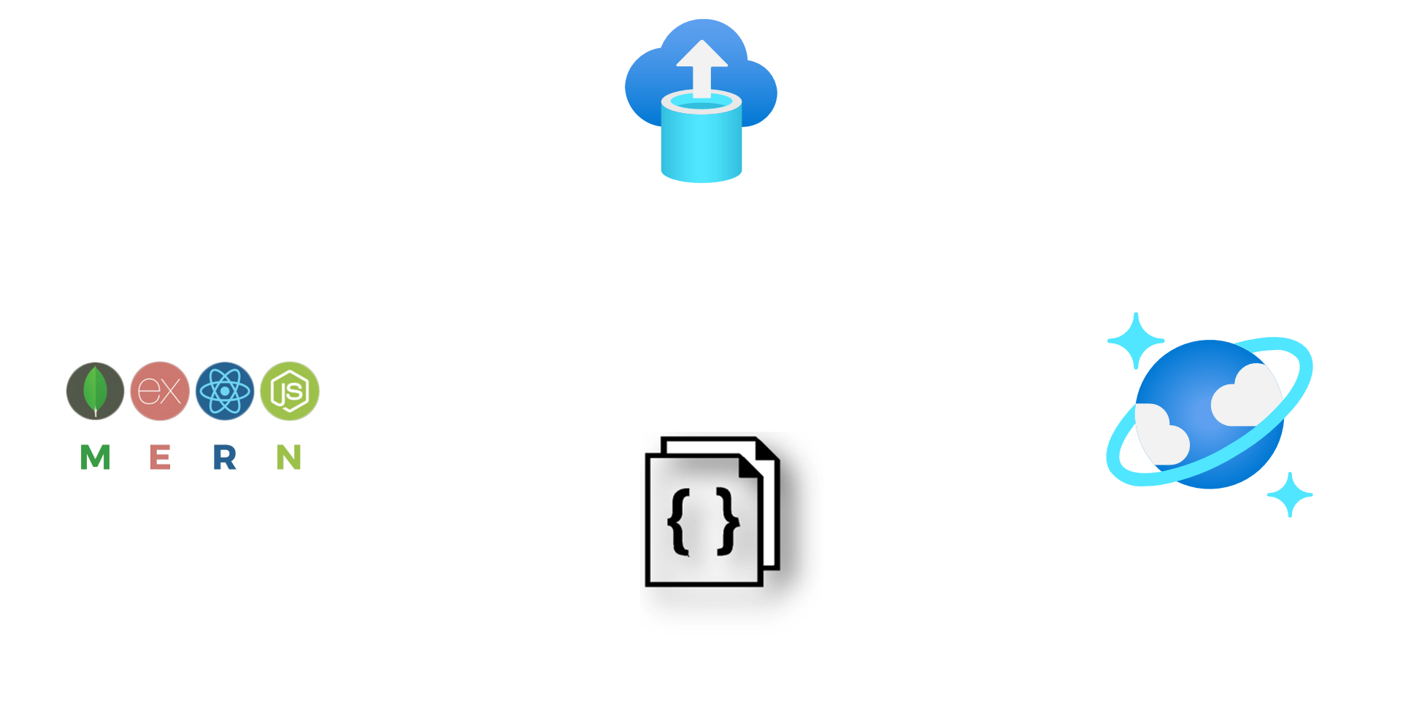
Preferred solution: Database migration
Notes:
What service would you recommend for hosting Best For You Organics Company’s MongoDB in Azure, and ensuring they can continue to use the MongoDB API for accessing their data?
Azure Cosmos DB databases can be used as the data store for apps written for MongoDB.
Using existing drivers, your application written for MongoDB can now communicate with Azure Cosmos DB and use Azure Cosmos DB databases instead of MongoDB databases.
Using this functionality, you can easily build and run MongoDB database applications in the Azure cloud with Azure Cosmos DB's global distribution and comprehensive industry-leading SLAs, while continuing to use familiar skills and tools for MongoDB.
What application changes need to be made to accommodate using a Cosmos DB database with MongoDB API? Be specific about the impact of the change on their application code.
In many cases, you can switch from using MongoDB to Azure Cosmos DB by simply changing a connection string.
You can use your existing MongoDB expertise, application code, and tooling as Azure Cosmos DB implements the MongoDB 3.4 (version 5) wire protocol and supports the MongoDB aggregation pipeline.
You can develop applications using MongoDB, and deploy them to production using the fully managed, and globally distributed Azure Cosmos DB service.
In other words, your application only knows that it's connecting to a database using MongoDB APIs. It is transparent to the application that the data is stored in Azure Cosmos DB.
How would you handle importing their existing data into Azure Cosmos DB? What factors do you need to consider when doing the import?
The MongoDB database can be migrated to Azure Cosmos DB using Azure Database Migration Service (DMS). DMS allows for both online (minimal downtime) and offline (one-time) migration of the database.
Alternatively, data from MongoDB can be imported into Azure Cosmos DB using either mongoimport.exe or mongorestore.exe, both available from the MongoDB Download Center.
With either, you will need to retrieve your Cosmos DB connection string information (host, port, username, and password) to complete the import.
Things to consider:
Throughput: The duration of your data migration depends on the amount of throughput you set up for your collections. For larger data migrations, you should increase the throughput to speed up the process. After the migration is complete, you can decrease the throughput to save costs.
SSL: Azure Cosmos DB has strict security requirements and standards. Be sure to enable SSL when you interact with your account.

Slide 17
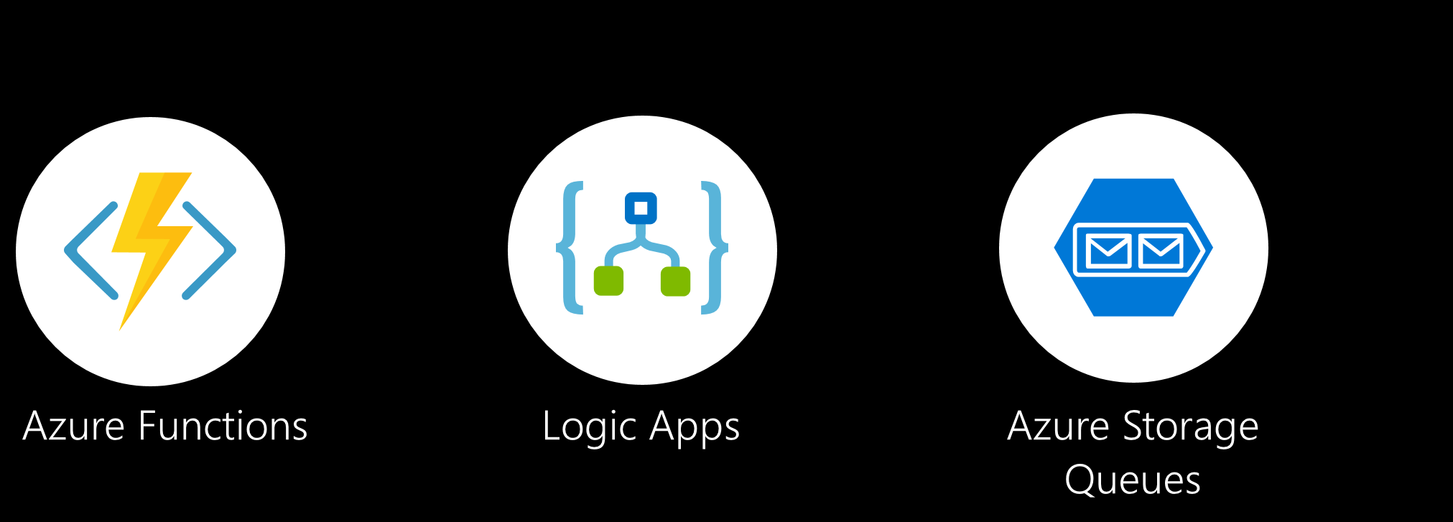
Preferred solution: Serverless architecture
Notes:
What serverless technologies would you recommend Best For You Organics Company use for automating their order processing?
They should use Azure Functions for automating their order processing.
A Function with an Azure Cosmos DB trigger could be used to queue up new orders for processing as they are received. A second Function could handle processing the items in the queue, and ensuring the order are updated when processing is completed.
Azure Storage Queues should be for the queueing technology. Given the customers need to process orders daily, the lifetime of the messages in the queue will be less than a day, and should the queue fail, a subsequent worker can continue from where the prior worker left off. They do not require some of the more advanced queueing features offered by Service Bus.
How would you recommend Best For You Organics Company handle notifying customers that their order has been processed? Are there specific Azure services that can be used?
Logic Apps can be used to send SMS messages via Twilio to customers.
Best For You Organics Company can implement a Logic App to notify customers of their order status. The logic app would include an Azure Queue trigger, linked to the notification queue populated by one of their Azure Functions, which would trigger whenever an order is finished processing, and a notification queue item is added.
A Twilio connector could act as the action to perform, which sends an SMS message when the trigger fires. The Best For You Organics Company would sign up for a Twilio account to get an API key, and would then provision a Twilio connector within the logic app, and add the credentials. Next, they would select a Send Message action using data provided in the queue message, specifically the customer’s phone number and first name to include in the message, such as “Hello Steve, your Best For Your Organics weekly order has shipped!”

Slide 18
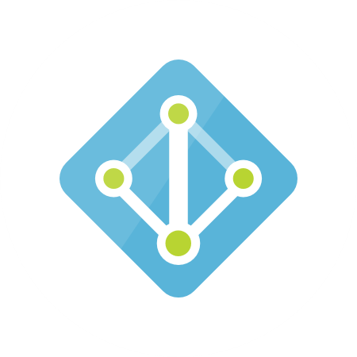
Preferred solution: Identity management
Azure Active Directory B2C
Global identity management system
Supports OpenID Connect
Notes:
How would you recommend Best For You Organics Company implement identity management in their customer-facing application?
DKSH could leverage Azure Active Directory Business to Consumer (B2C) to manage their customer's usernames and passwords. They would need to provision an Azure Active Directory B2C instance within their Azure subscription. AAD B2C provides a highly available, global, identity management service for customer-facing applications, which can be easily integrated into mobile and web platforms.
For web apps (including .NET, PHP, Java, Ruby, Python, and Node.js) that are hosted on a server or in a container, and accessed through a browser, Azure AD B2C supports OpenID Connect for all user experiences. This includes sign-in, sign-up, and profile management. In the Azure AD B2C implementation of OpenID Connect, your web app initiates these user experiences by issuing authentication requests to Azure AD.

Slide 19

Preferred solution: Search integration
Azure Cognitive Search
Index data from Azure Cosmos DB
Use secure Node.js API App
Imbed HTML and CSS for search term highlighting
Notes:
How could Azure Cognitive Search be integrated into the OSS application?
The search index would be built on the meal option data stored in Cosmos DB. The DKSH team could then create a Node.js API App, secured by Azure AD B2C, which wraps the Azure Cognitive Search API. To perform a search, a browser loads the web page on a device and makes a cross-origin, XmlHttpRequest to the API app. Meals and plan options matching the search terms are returned, with HTML and CSS formatting embedded, so the text that matches the search query is highlighted in the displayed results.

Slide 20
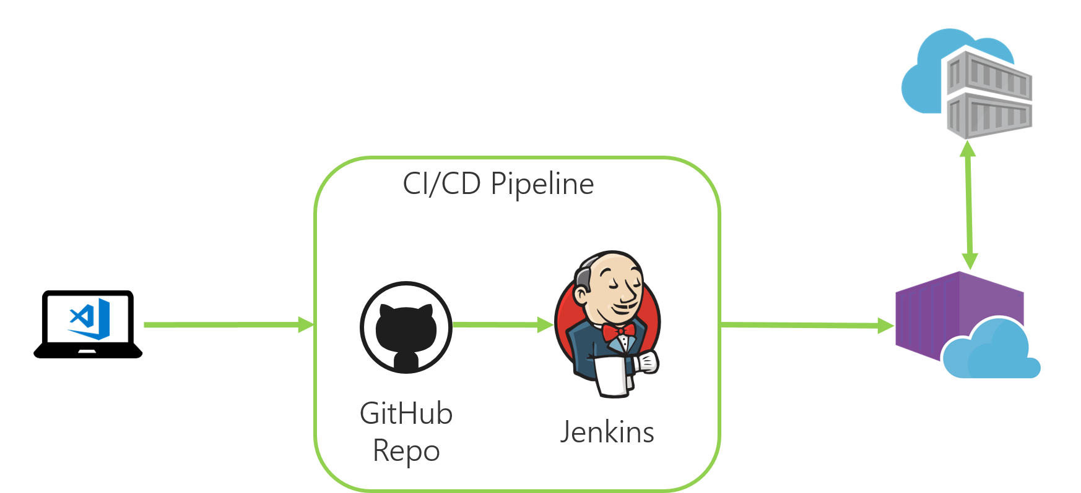
Preferred solution: DevOps workflows
Notes:
How can Jenkins be used to help the customer create a full CI/CD pipeline?
Web Apps for Containers not only adds the power of Microsoft Azure to your application, such as security, load balancing, auto-scaling, and automated management, but also allows you to take advantage of its DevOps capabilities, such as continuous deployment from Jenkins, GitHub, Docker Hub, and other sources, package management, staging environments, custom domain, and SSL certificates.
Using the Azure App Service Jenkins plugin, you can automate your deployments so that you can deliver your apps/services easily and often. You can set up a CI/CD process all on Azure DevOps. However, if you already have a CI pipeline with a third-party tool, such as Jenkins, you can continue to use those tools to implement your CI/CD pipeline.
Using the customer's existing Jenkins server and build pipeline, they could add a post-build action to publish an Azure Web App. Using the Azure App Service plug-in for Jenkins, you can build and deploy a docker container to the App Service underlying the Web App for Containers in Azure.

Slide 21
Preferred objections handling
Can Azure PaaS really host an OSS app?
Are containers a feasible option in Azure?
Can Azure help improve our DevOps workflow?
Is Azure AD B2C an option with OSS apps?
Notes:
Is Azure an appropriate platform for hosting an OSS application using PaaS?
Yes. If you’re a OSS developer, Azure offers more than you might expect—from virtual machines to managed services, functions, and containers. With Azure, you get full stack capabilities, including:
Integration with popular—and free—open source tools such as Visual Studio Code.
Monitoring services with Application Insights to catch bugs, optimize apps, and stay on top of their status.
Comprehensive managed database support with Cosmos DB (compatible with MongoDB), MySQL, and PostgreSQL.
Support for a variety of platforms and frameworks to help with both new microservices-based apps and existing apps.
Global, trusted cloud infrastructure.
We’re interested in using containers, but we’re not sure how they work in Azure. Does Azure provide reliable ways to deploy and manage containers? What is the simplest way to move containers to Azure, based on our PaaS experience, while at the same time considering our scale and growth requirements?
Microsoft Azure provides integrated tools for developing and managing containerized applications faster. Deploy containers using widely adopted orchestrators, or choose a fully-managed container platform. Take advantage of Visual Studio Tools for Docker to easily develop, run, and debug multi-container applications, and store images in Docker Hub or Azure Container Registry and deploy to your preferred targets.
Azure Container Registry (ACR) is a private registry for hosting container images. Using the Azure Container Registry, you can store Docker-formatted images for all types of container deployments. Azure Container Registry integrates well with orchestrators hosted in Azure Container Service, including Docker Swarm, DC/OS, and Kubernetes. You don’t have to learn new APIs or commands. Because Azure Container Registry is compatible with the open-source Docker Registry v2, you can use the same open-source Docker CLI tools you already know and the skills you have to efficiently interact with the registry.
Microsoft designed Web App for Containers specifically for customers interested in bringing their Docker formatted containers to the Azure App Service platform. Web App for Containers provides an ideal environment for running OSS web apps that do not require extensive infrastructure control, allowing customers to use their own containers, and deploy them to App Service as a web app running on Linux. Like the Web App solution, this eliminates time-consuming infrastructure management tasks during container deployment, updating, and scaling to help developers focus on coding and getting their apps in front of more end users faster. This also provides integrated CI/CD capabilities with DockerHub, Azure Container Registry, and Azure DevOps, as well as built-in staging, rollback, testing-in-production, monitoring, and performance testing capabilities to boost developer productivity.
This solution also allows organizations to take advantage of built-in auto-scaling and load balancing. Automatically scale vertically and horizontally based on application needs. Granular scaling rules are available to handle peaks in workload automatically while minimizing costs during off-peak times. Deploy data and host services across multiple locations with just few mouse clicks.
We would like to improve our current DevOps workflow. What options are available in Azure? Can we implement a CI/CD pipeline? Can we continue to use Jenkins? Does Azure offer any value-added services which we can leverage in our Jenkins CI/CD pipeline?
Jenkins integrates seamlessly with Azure DevOps, making it easy to use Jenkins and Azure DevOps to create a full CI/CD pipeline. Using the Jenkins Team Foundation Server (TFS) plugin, we can configure a project to pull from GitHub, build in Jenkins, and deploy with Azure DevOps.
The Azure App Service Jenkins plugin can be used to deploy directly from Jenkins into Azure App Service.
Using Web App for Containers, you can streamline CI/CD with Docker Hub, Azure Container Registry, and GitHub. Automate and simplify your container image deployments through continuous integration/continuous deployment (CI/CD) capabilities with Docker Hub, Azure Container Registry, and Visual Studio Team Services. App Service creates an association with the selected repository, so your apps are updated each time your source code changes. Schedule performance and quality tests in staging environment, and use deployment slots to swap staging to production in seconds, or roll back to previous versions without downtime.
We’ve heard about Azure Active Directory B2C to manage application users, but we are not sure how that would work with our open source application.
Azure AD B2C is a highly available, global, identity management service for customer-facing applications that scales to hundreds of millions of identities. It can be easily integrated across mobile and web platforms. Your customers can log on to all your applications through fully customizable experiences by using their existing social accounts or by creating new credentials.
Protect your consumer's identities
Login with social media accounts
Customizable user experiences
Pay only for what you use
For web apps (including .NET, PHP, Java, Ruby, Python, and Node.js) that are hosted on a server or in a container, and accessed through a browser, Azure AD B2C supports OpenID Connect for all user experiences. This includes sign-in, sign-up, and profile management. In the Azure AD B2C implementation of OpenID Connect, your web app initiates these user experiences by issuing authentication requests to Azure AD.

Slide 22
Customer objection handing
Is Azure Search an appropriate solution for improving our search capabilities?
Can we continue to use MongoDB API?
How can use leverage serverless architecture?
Can we continue using our development tools, or is VS Code a better option?
Notes:
Is Azure Search an appropriate solution for improving the search capabilities of our OSS app?
Yes. Microsoft Azure Search is capable of integration into OSS applications. Azure Search is a search-as-a-service solution that allows developers to embed a sophisticated search experience into web and mobile applications without having to worry about the complexities of full-text search and without having to deploy, maintain or manage any infrastructure. With Azure Search you can surface the power of searching data in your application, reduce the complexity around managing and tuning a search index, and boost development speed using familiar tools and a consistent platform.
Will we be able to continue using the MongoDB API, while benefiting from the scalability and reliability of a PaaS database platform?
You can use your existing MongoDB expertise, application code, and tooling as Azure Cosmos DB implements the MongoDB 3.4 (version 5) wire protocol and supports the MongoDB aggregation pipeline. You can develop applications using MongoDB, and deploy them to production using the fully managed, and globally distributed Azure Cosmos DB service. In other words, your application only knows that it's connecting to a database using MongoDB APIs. It is transparent to the application that the data is stored in Azure Cosmos DB.
We would like to understand more about the benefits of a serverless architecture. In Azure does it mean only using Azure Functions or is there more to it?
A Serverless Architecture, as the name implies, aims to provide a solution architecture where concern for individual servers is minimized. While the term “Serverless” has varying interpretations, it typically includes characteristics such as the extensive use of ephemeral services, a focus entirely on scaling the capabilities that support the business logic, the processing capability should be ephemeral (e.g., it can be started nearly instantaneously without pre-provisioning on your part), the capability is scaled transparently at a very granular level (e.g. scaling occurs on a per request or function invocation basis and not on an all up server load basis), and the cost is typically associated with time spent supporting business logic computation and not on the time server resources are available to handle requests.
In Azure, Functions is a prime component of a serverless architecture, but not the only service that may be utilized in one. Other Azure Services that, by this definition, can be composed into a serverless architecture include: Logic Apps, Azure Storage Blobs, Tables and Queues, Azure Data Lake Store, API Management, CDN, Media Services, Notification Hubs, IoT Hub, and Service Bus.
We’ve read that Visual Studio Code is a free, open source code editor that can be used for OSS development. Can our developers continue to use their IDE, or do they need to switch over to using Visual Studio Code to write code destined for the Azure platform? Does Visual Studio Code offer any features or integration capabilities that would make it advantageous over a non-Microsoft IDE?
Development teams that prefer to use their existing tools for building Azure applications, can continue to do so. Popular code editors, like WebMatrix and IntelliJ, offer integration with Microsoft Azure and Azure DevOps, allowing developers to easily create, develop, test, and deploy Azure applications.
Visual Studio Code is a lightweight open source code editor which runs on your desktop, and is available for Windows, maxOS, and Linux. At its heart, VS Code features a lightning fast source code editor, with support for hundreds of languages. VS Code helps developer productivity with syntax highlighting, bracket-matching, auto-indentation, box-selection, snippets, and more.
For serious coding, you'll often benefit from tools with more code understanding than just blocks of text. Visual Studio Code includes built-in support for IntelliSense code completion, rich semantic code understanding and navigation, and code refactoring. It also includes an interactive debugger, so you can step through source code, inspect variables, view call stacks, and execute commands in the console.
VS Code features rich integration with build and scripting tools to perform common tasks making everyday workflows faster, including an integrated terminal, which allows developers to stay within the development environment to perform quick command-line tasks. The VS Code Extension Marketplace lets you add languages, debuggers, and tools to your installation to support your development workflow, allowing VS Code to be tailored to your specific development needs and preferences.

Slide 23
Questions?
Notes:
Present schedule for day 2 and day 3

